Slide 1
Lesson objective
Test on Thursday
Title: Indices and factors
Aim:
Be able to simplify multiplication with multiple bases
Apply BIMDAS when simplifying indices
Plan:
Daily review
Prime factors
Multiple bases
BIMDAS
Need whiteboards

Slide 2

Match the law to the math
$$4^{3} × 4^{7}=$$
$$\frac{8^{9}}{8^{4}}=$$
$${(5^{6})}^{8}$$
Third law (multiply indices)
Seconds law (Subtract indices)
First Law (Add indices)

Slide 3
Prime factor form
What is a prime number?
A: A number that has exactly two factors, one and itself.
Prime factor form:
- Expressing a number as a product of its prime factors

Slide 4
Creating factor trees
https://www.youtube.com/watch?v=9k2--A3RNyA
70 50 80

Slide 5
Write factor trees
45
20
60
100

Slide 6
Add to notes page (BLUE sheet)
Writing as a prime factor.
Divide number by a prime
Repeat on branches until only primes remain
70

Slide 7
Simplifying with multiple bases
Simplify:
2 x 2 x 3 x 3 x 2 x 3 x 2
8 x 8 x 8 x 8 x 9 x 9 x 8
a x 3 x a x a x 3 x a x 3

Slide 8
Whiteboards
4 x 4 x 4 x 5 x 5 x 5 x 4
7 x 8 x 7 x 8 x 7 x 8 x 7 x 8 x 7
a x 7 x a x a x a x 7 x 7

Slide 9

BIMDAS
What should you do first?
( 10 – 6 ) x 3
What about:
$${\left(\frac{5^{4}}{5^{2}}\right)}^{3}$$
$${(3^{4} × 3^{2})}^{4}$$

Slide 10

Whiteboards
$${\left(\frac{8^{9}}{8^{2}}\right)}^{3}$$
$${(7^{4} × 7^{3})}^{4}$$
$$({\frac{4^{6}×3^{8}}{4^{5}×3^{5}})}^{2}$$

Slide 11
Formative task
Does not go towards grade.
Use it to see where we are up to, and what we need to work on.

Slide 12
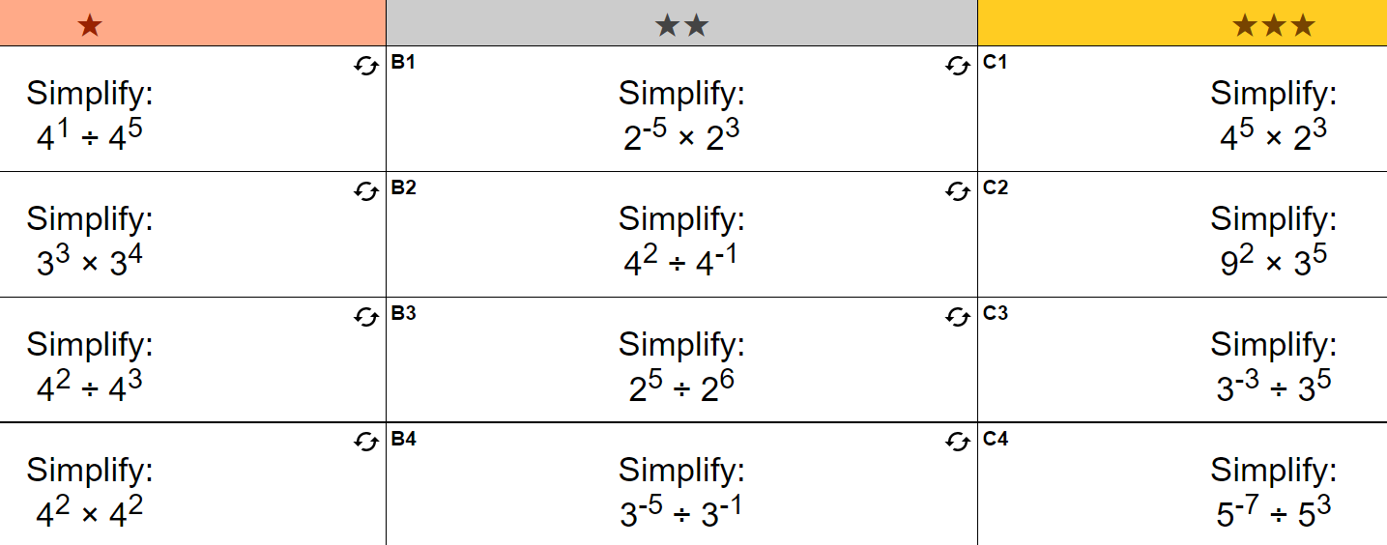

Slide 13
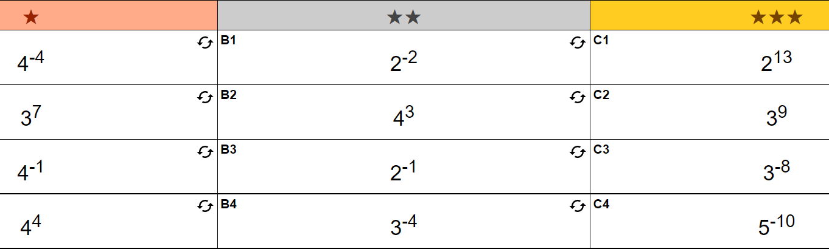
Answers

Slide 14
Reflection
Aim:
Be able to simplify multiplication with multiple bases
Apply BIMDAS when simplifying indices

